Slide 1
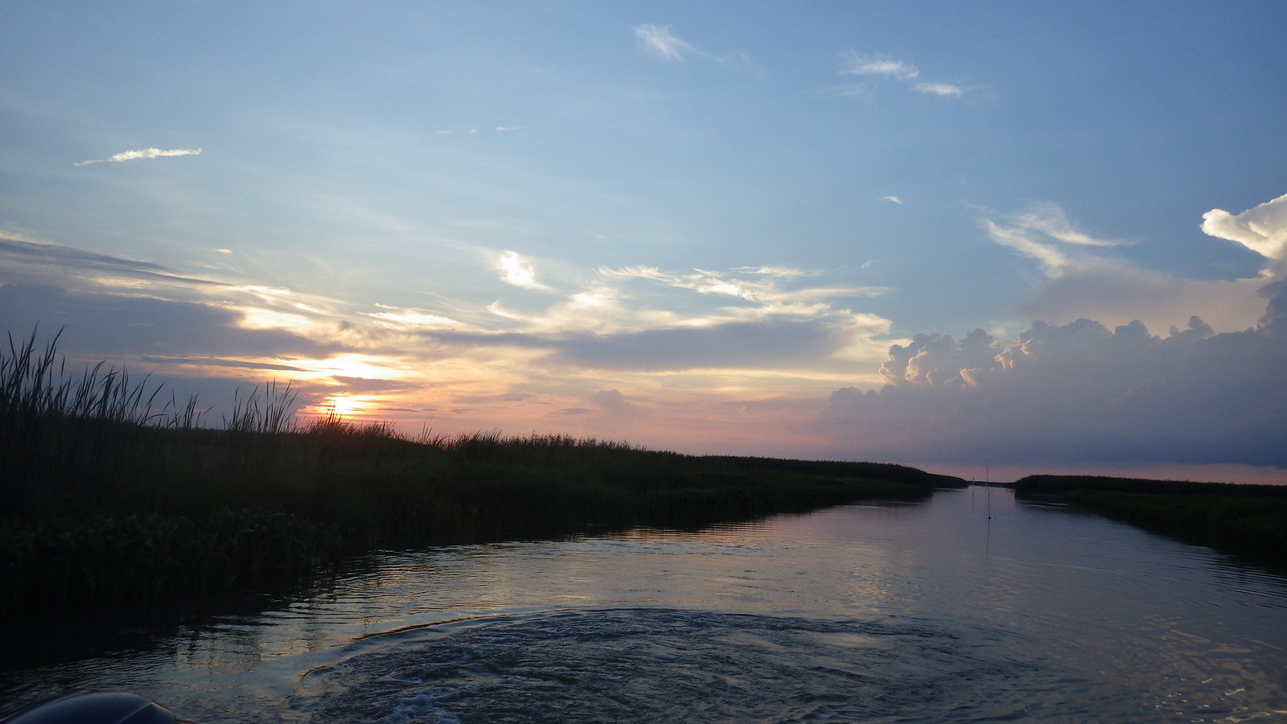

Capital Area Ground Water Conservation Commission
June 11, 2018

Slide 2
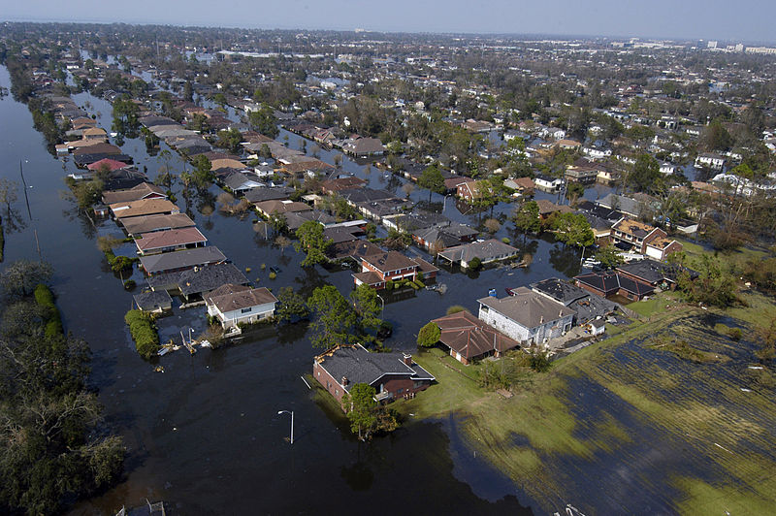
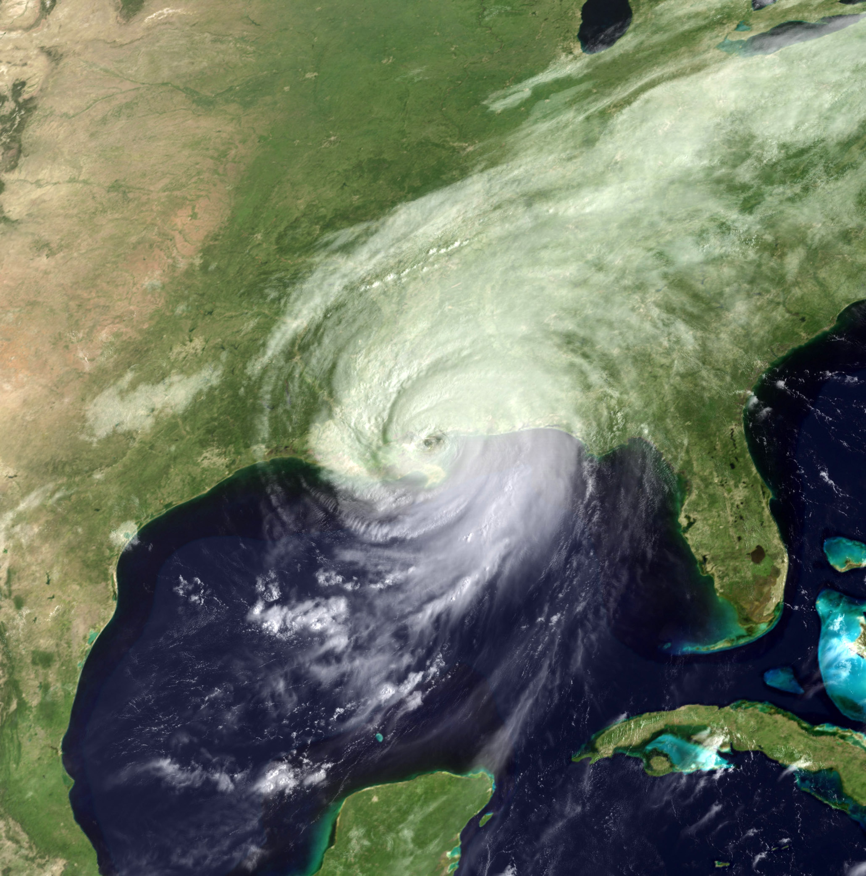
Post-Hurricane Katrina

Slide 3
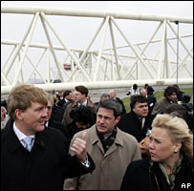
New approach sought
Louisiana leaders look for new approach to water management
Multiple trips to Netherlands and Deltares
Determined need to set up a research institute based on Deltares model

Slide 4
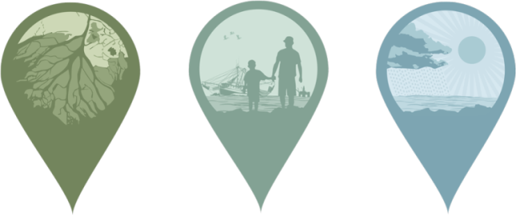
About Us
The Water Institute of the Gulf is a not-for-profit, independent research and technical services resource for resilient coasts and sustainable water systems worldwide.
The work of the Institute helps ensure livable communities and a thriving economy and environment.
Notes:
Began operations in February 2012
Operations based in Baton Rouge, Louisiana
Founding Partners: State of Louisiana (Governor Jindal), Baton Rouge Area Foundation, Senator Mary Landrieu

Slide 5
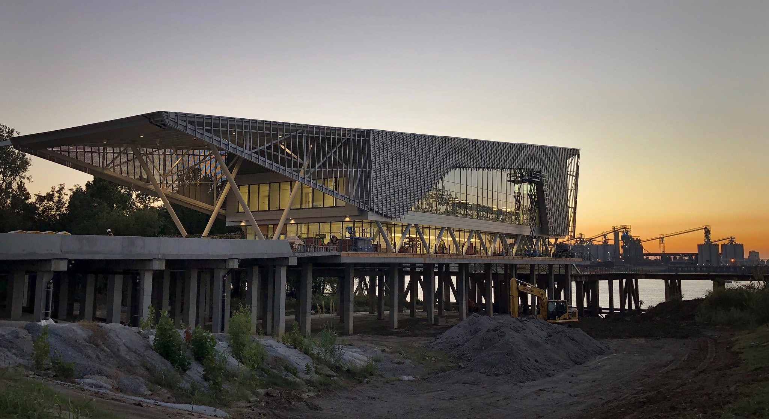
The water institute of the gulf

Slide 6
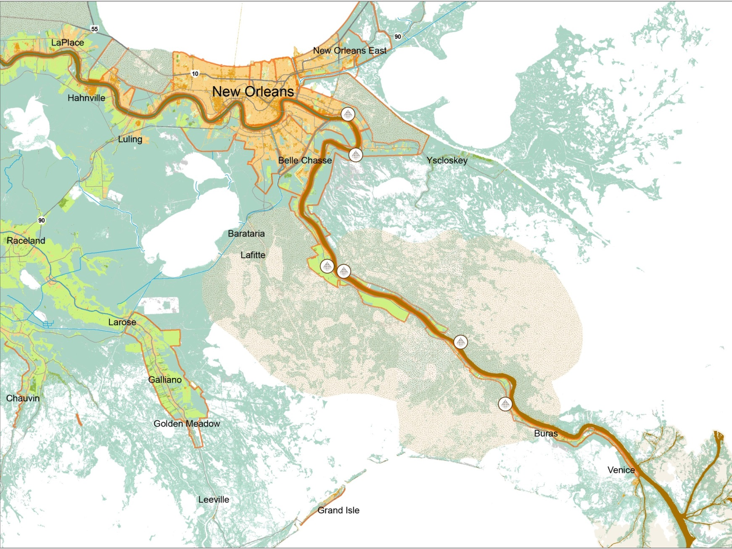

AN integrated approach to solving the challenges of Coastal Louisiana and the Mississippi river delta
Modeling and Monitoring
Physical Processes and Sediment Systems
Human Dimensions
Coastal Systems Ecology
Policy Research

Slide 7
Strategic Long-Term Plan
Objectives
1: Work with the CAGWCC and other technical stakeholders to identify and evaluate feasible, realistic, and cost-effective science-based alternatives which meet long-term water resource needs.
2: Evaluate the state of the science/information related to groundwater use and aquifer conservation needed to evaluate alternatives and inform decisions.
3: Work with the CAGWCC to identify management alternatives that are economically feasible and acceptable, and to develop a strategic plan for the long-term water supply for the District.

Slide 8
proposed phased approach
State of the Science
Problem
Objectives
Alternatives
Consequence Analysis
Tradeoffs and Optimization
Decide and Take Action
PrOACT Framework for Structuring Decisions:
Defining the Problem
Determining the Objectives
Identifying Alternatives
Evaluating alternatives and forecasting the Consequences
Evaluating the Trade-offs
Making the decision and taking action
Phase
1
Phase
3
Phase
2

Slide 9
Phased Approach
Phase 1: Facilitated Workshops & Scientific Review (currently proposed)
  Phase 1.1: Facilitated Workshops
  Phase 1.2: Scientific Review
  Time: 1 year
Phase 2: Alternatives Analysis
  Phase 2.1: Filling Gaps and Evaluate alternatives
  Phase 2.2: Selection of alternative(s)
Phase 3: Long-Term Strategic Plan
  Phase 3.1: Develop Strategic Action Plan
  Phase 3.2: Stand up Strategic Plan Systems
  Phase 3.3: Strategic Plan Implementation Support

Slide 10

Questions?
1110 RIVER ROAD S., SUITE 200, BATON ROUGE, LA. 70802
225-448-2813
WWW.THEWATERINSTITUTE.ORG

